Slide 1

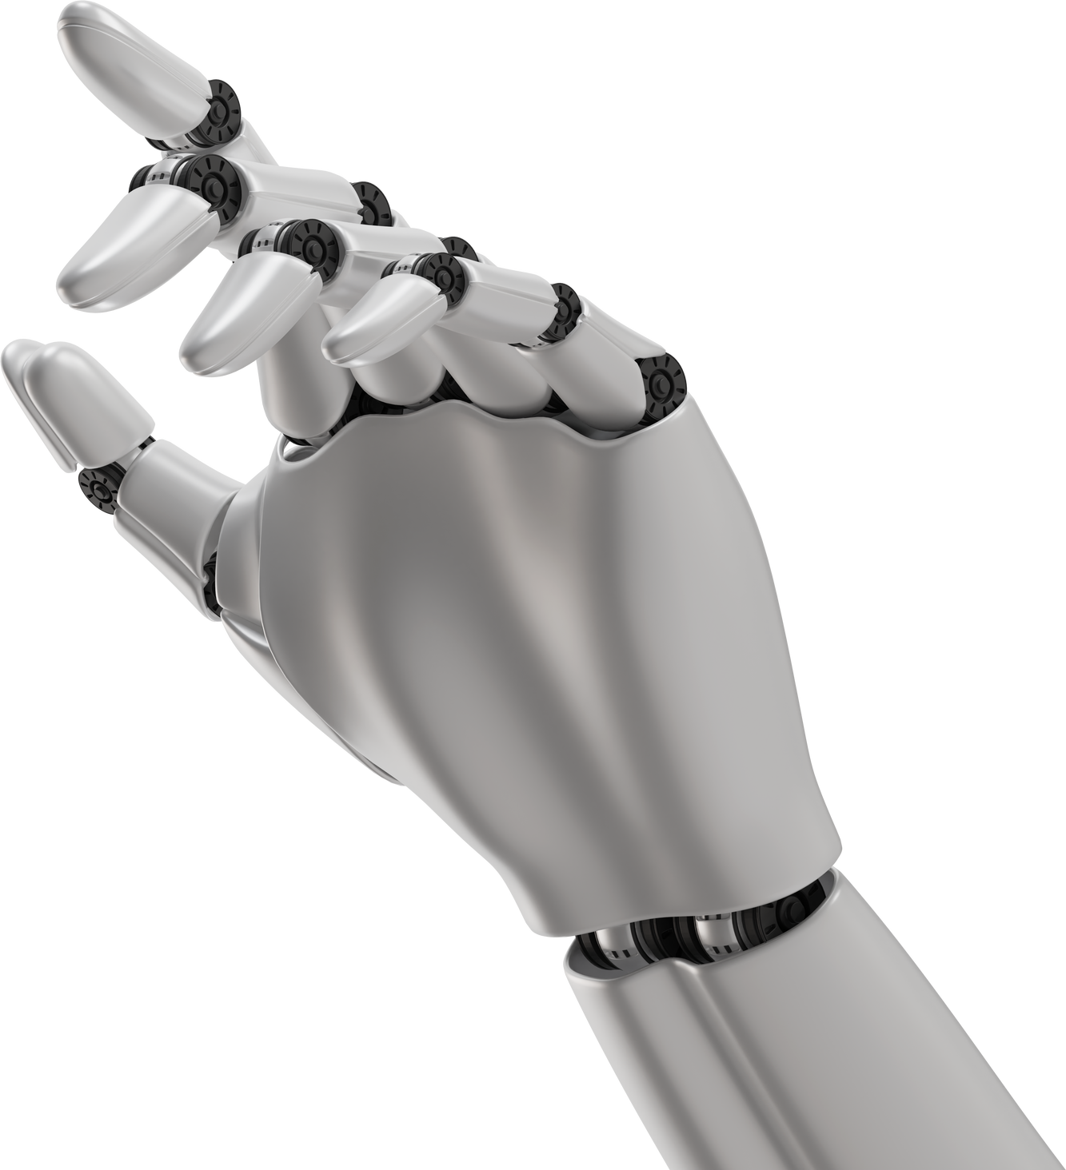
MACHINE LEARNING
Clustering Algorithms
Devi Priya v

Slide 2
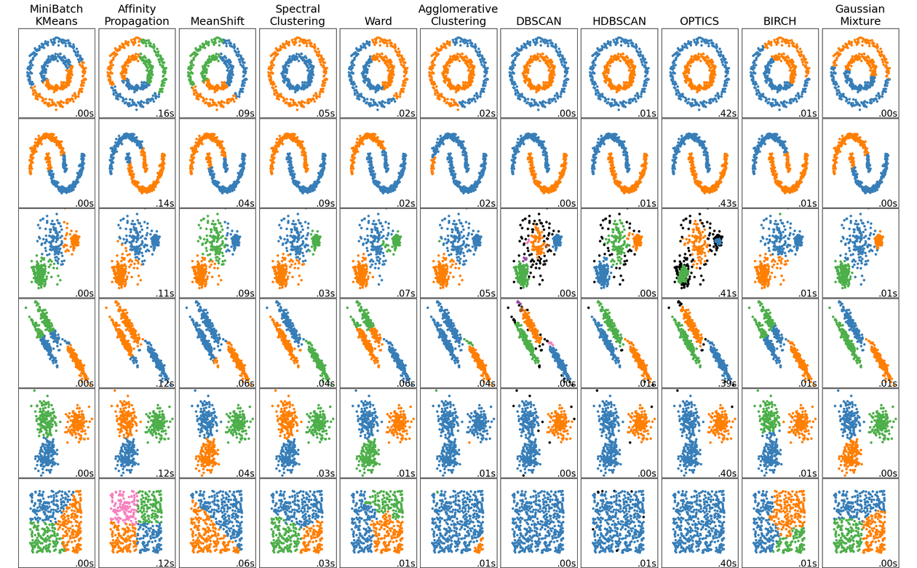
Introduction to Clustering Algorithm's
Clustering is an unsupervised learning technique used to group similar data points.
Helps in data segmentation, pattern recognition, and exploratory data analysis.

Slide 3


Types of Clustering
• Hard Clustering: Each data point belongs to one cluster (e.g., K-Means).
• Soft Clustering: Data points can belong to multiple clusters (e.g., Fuzzy C-Means).
• Hierarchical Clustering: Organizes data in a tree structure.

Slide 4
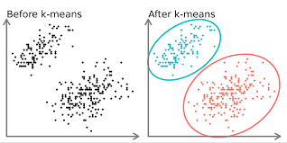
K-Means Clustering
• Centroid-based algorithm that partitions data into K clusters.
Steps:
1. Choose K cluster centers.
2. Assign each data point to the nearest cluster.
3. Update centroids until convergence.
.
Advantages:
Simple and scalable.
Disadvantages:
Sensitive to initial centroids and outliers

Slide 5
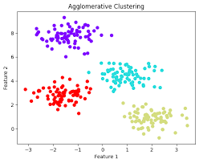
Hierarchical Clustering
• Builds a tree-like hierarchy of clusters.
• Types:
- Agglomerative (bottom-up approach).
- Divisive (top-down approach).
• Advantages: No need to specify K.
• Disadvantages: Computationally expensive.

Slide 6
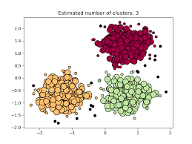
DBSCAN (Density-Based Clustering)
• Groups dense regions and identifies noise points.
Parameters
- Epsilon (ε)
:
Defines neighborhood radius.
- MinPts
:
Minimum points in a dense region.
Advantages
Disadvantages
Detects arbitrary shapes.
Sensitive to parameters.

Slide 7
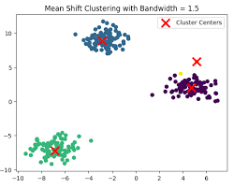
Mean Shift Clustering
• Centroid-based approach that shifts points towards higher density regions.
• Works well without specifying K.
• Computationally expensive.

Slide 8

Evaluating Clustering Performance
• Metrics:
- Silhouette Score.
- Davies-Bouldin Index.
- Dunn Index.
- Inertia (for K-Means).

Slide 9

Applications of Clustering
• Customer segmentation in marketing.
• Anomaly detection in cybersecurity.
• Image segmentation in computer vision.
• Recommender systems.

Slide 10
CONCLUSION
• Clustering is a fundamental unsupervised learning technique.
• Various algorithms exist with different strengths and weaknesses.
• Choosing the right method depends on the dataset and use case.

